Slide 1
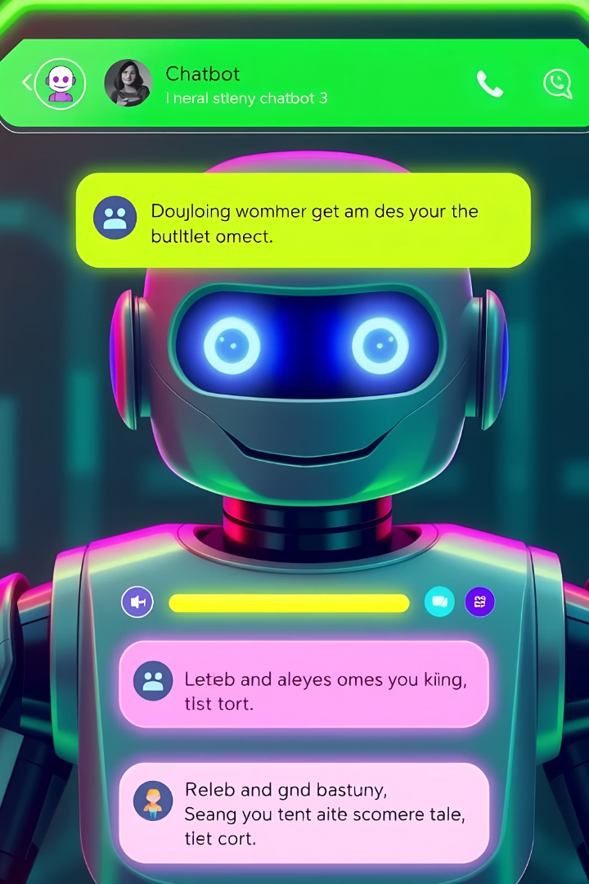
Designing an Ideal Multi-Step Dynamic Bot Conversation
Building a dynamic chatbot for college and course recommendations requires a structured yet flexible interaction flow. This presentation covers a multi-step process starting from subject group selection to suggested courses and colleges tailored to user preferences. We’ll explore backend logic, state management, and chatbot conversation designs to create a seamless user experience.
by Rakesh C
RC

Slide 2
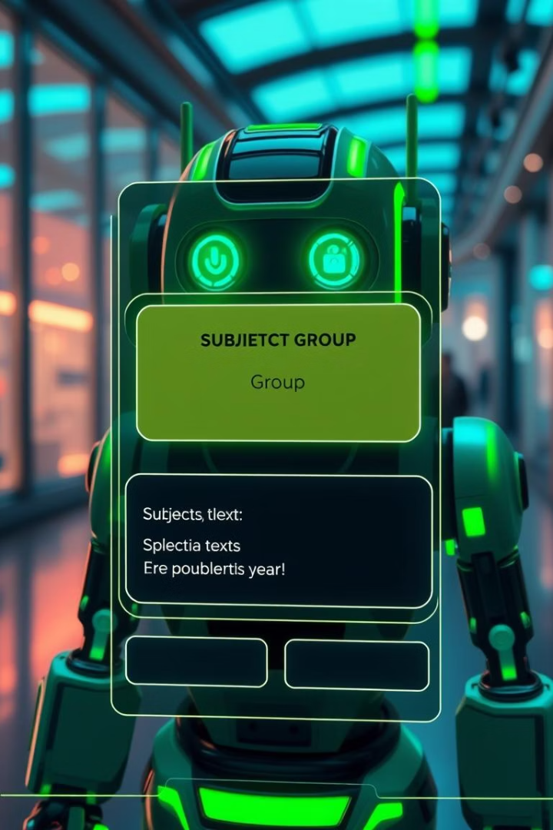
Step 1 & 2: Subject Group and Subject Selection
Step 1: Choose Subject Group
Options include Science Group, Science with Computer Science, Medical Science, Commerce, and Humanities. This step filters subsequent options and personalizes recommendations.
Step 2: Choose Your Subjects Within Group
For Science Group, subjects include Physics, Chemistry, Maths, Biology, Computer Science, and Languages like Tamil or English. Precise subject selection helps refine course and college suggestions.

Slide 3
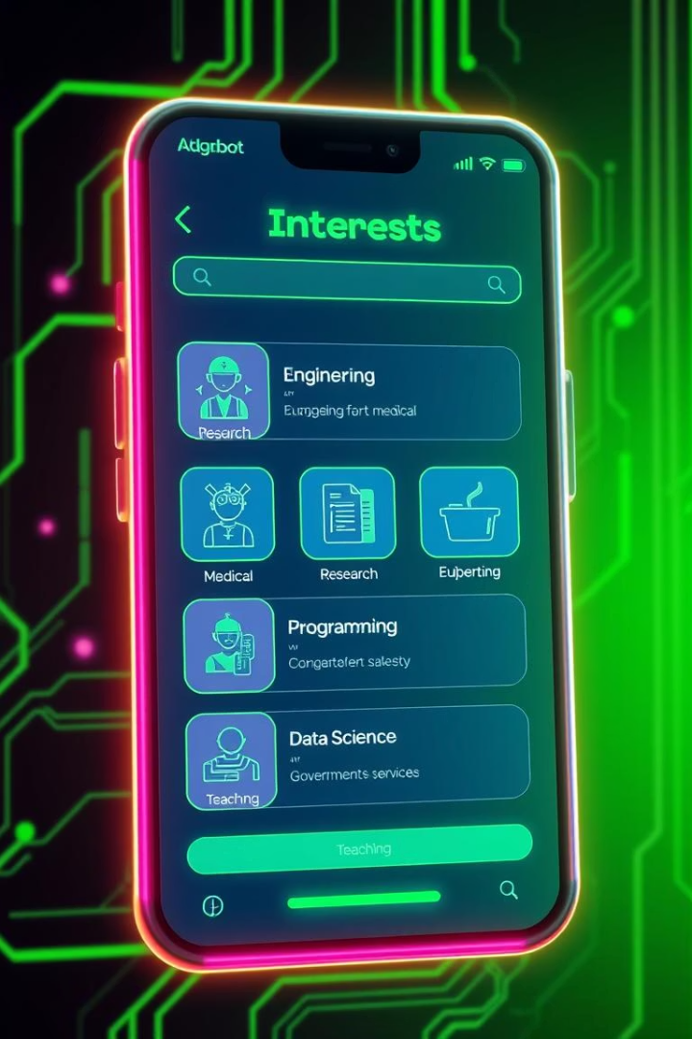
Step 3: Choosing Interests
Core Interest Options
Engineering
Research
Medical Field
Programming
Data Science
Government Services
Teaching
Why Interest Matters
Interest guides the chatbot to tailor recommendations towards relevant career paths and courses, improving user engagement and satisfaction with personalized advice.

Slide 4
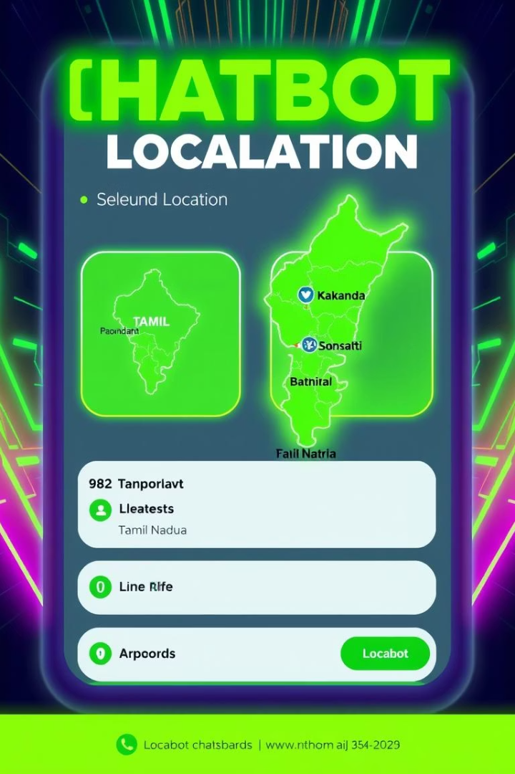



Step 4: Show Top Colleges (India & Tamil Nadu)
Top Colleges in India
Top Colleges in Tamil Nadu
User Filtering
Location preferences allow the chatbot to focus college suggestions and Filter by district or city; sort by rating, distance
🏆 Top Colleges in India: IIT Madras, NIT Trichy, BITS Pilani 🏆 Top Colleges in TN: PSG Tech, SSN, VIT, Anna University

Slide 5
College Selection & Admission Info
Admission Type
Exams & Cutoffs
Requirements
Entrance Exam or 12th Marks based
JEE, NEET, TNEA, CUET
Eligibility: subjects, min marks
Cutoff: Min %, percentile, rank
Documents
Application deadlines and links

Slide 6
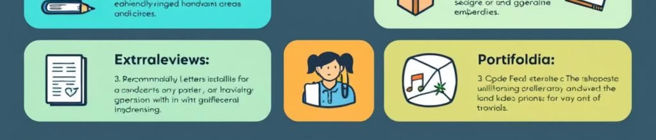



Choose Admission Mode
Entrance Exam
12th Marks
Filtering
Input exam type and scores (e.g., JEE, NEET, CUET)
Provide total marks or cutoff percentages
Filter colleges based on scores and admission mode

Slide 7
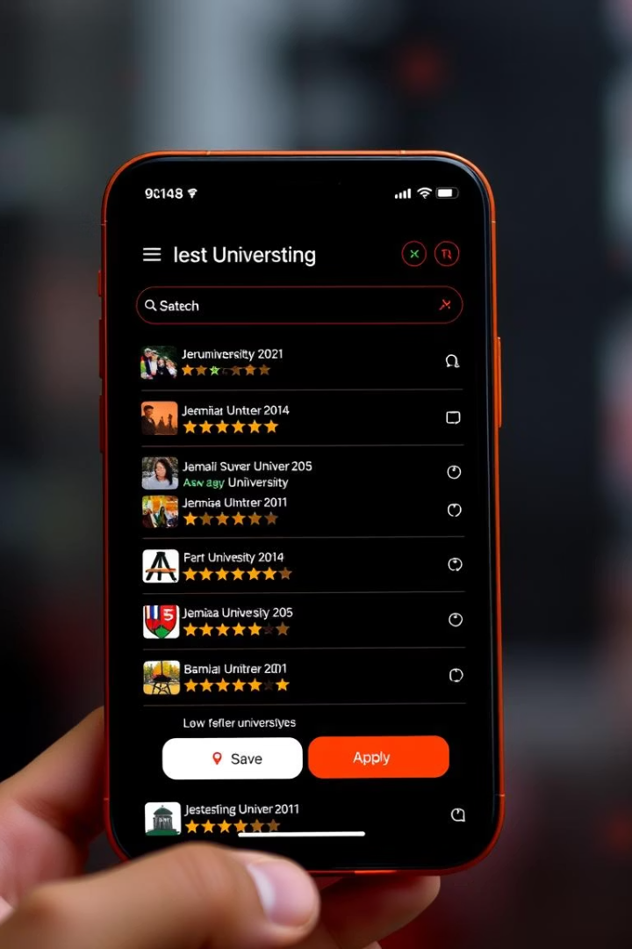



Filter & Suggest Eligible Colleges
Save Favorites
Share or Download PDF
Apply Online

Slide 8
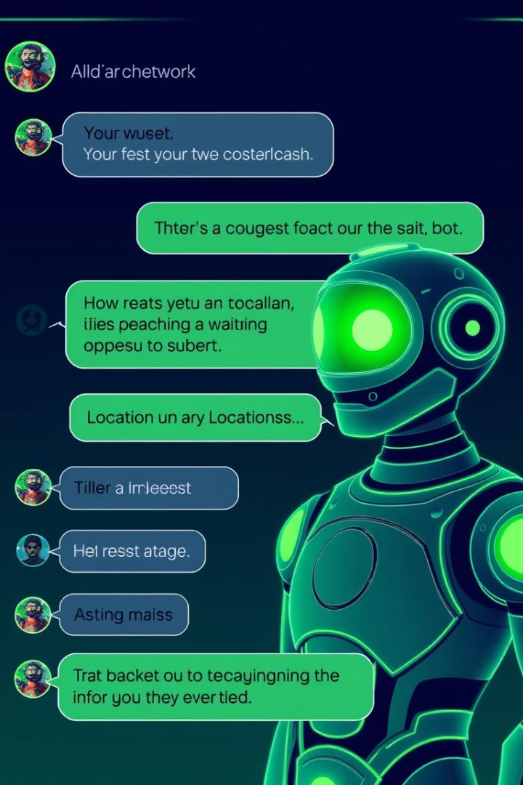
Example Structured Conversation and User Flow
Bot: Which group did you study?
User: Science with Biology.
Bot: Which subjects?
User: Physics, Chemistry, Biology, Maths, English.
Bot: What are you interested in?
User: Medicine.
Bot: Would you like to view top colleges in:
India
Tamil Nadu
By district?
User: Tamil Nadu.
Bot: Top Medical Colleges in Tamil Nadu:
Madras Medical College – Chennai
Stanley Medical College – Chennai
How do you want to filter colleges?
NEET percentile
12th cutoff
User: 12th cutoff.
Bot: Please enter your 12th PCB (Physics + Chemistry + Biology) cutoff mark.
User: 195.
Bot: With 195 cutoff:
✅ Government Medical College, Coimbatore – Min: 193 ✅ PSG IMSR (Private) – Min: 190 ❌ MMC Chennai – Min: 198 ❌ CMC Vellore – Requires NEET + Merit + Service criteria
Would you like to view their admission process or apply now?

